Slide 1
Introduction to Android
Lecture 1

Slide 2
Lectures Structure
1 hour - Presentation + live coding
1 hour 30 min – Task completion (feel free to ask any questions)
30 min – Wrap up and homework explanation
*5-10 minute breaks during lecture

Slide 3

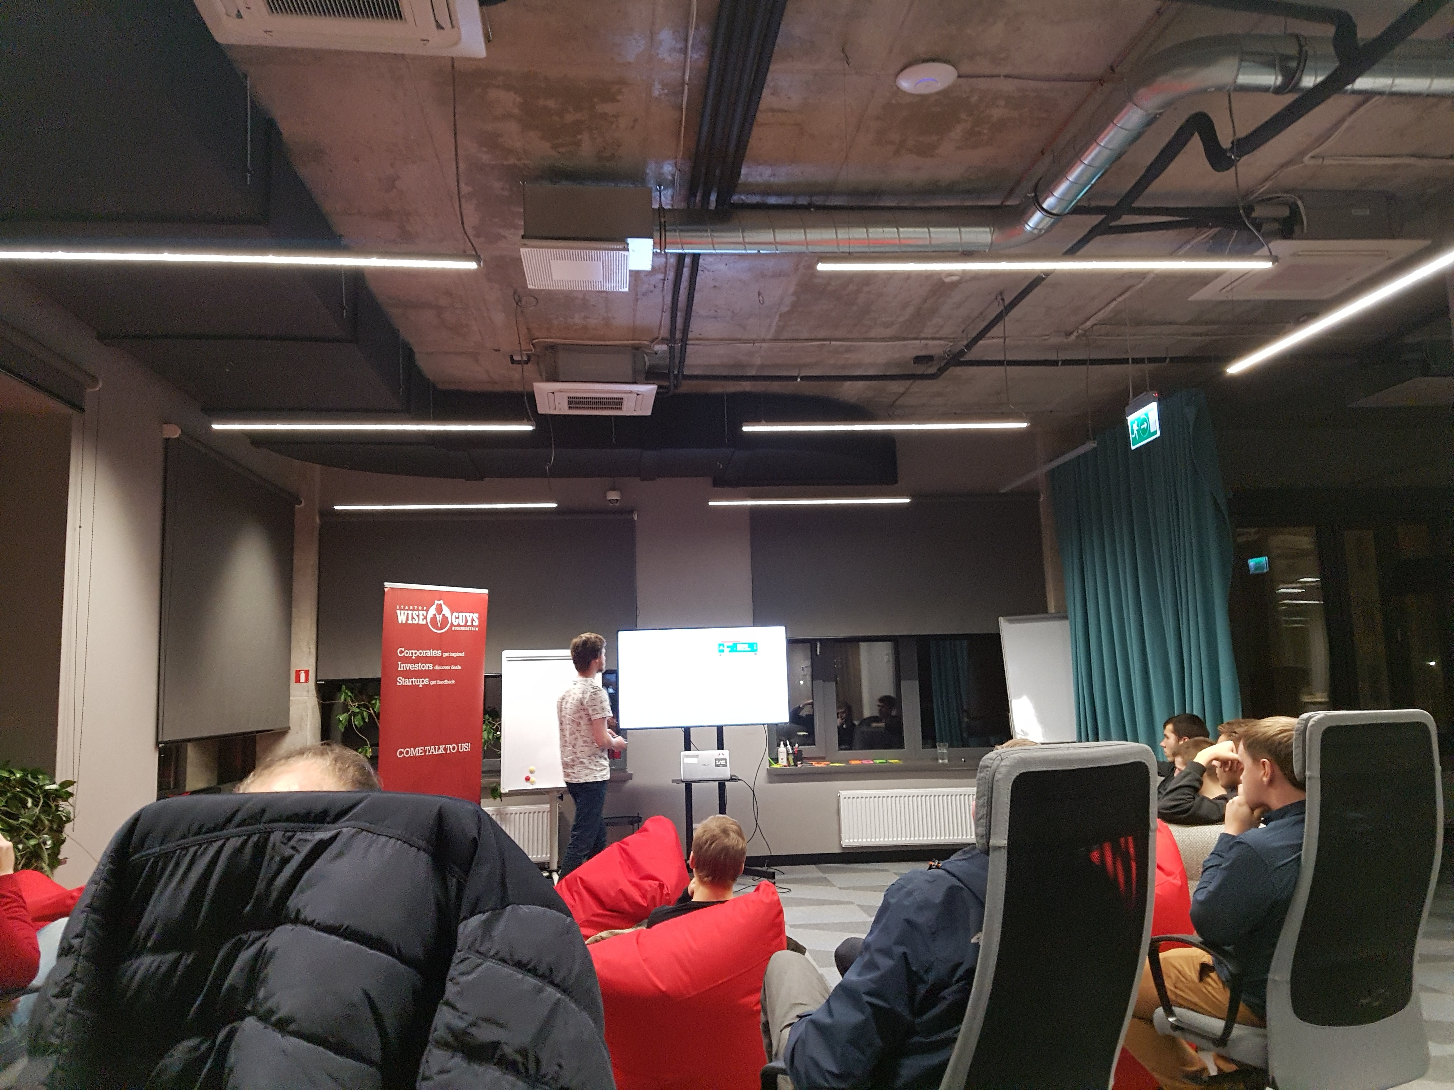
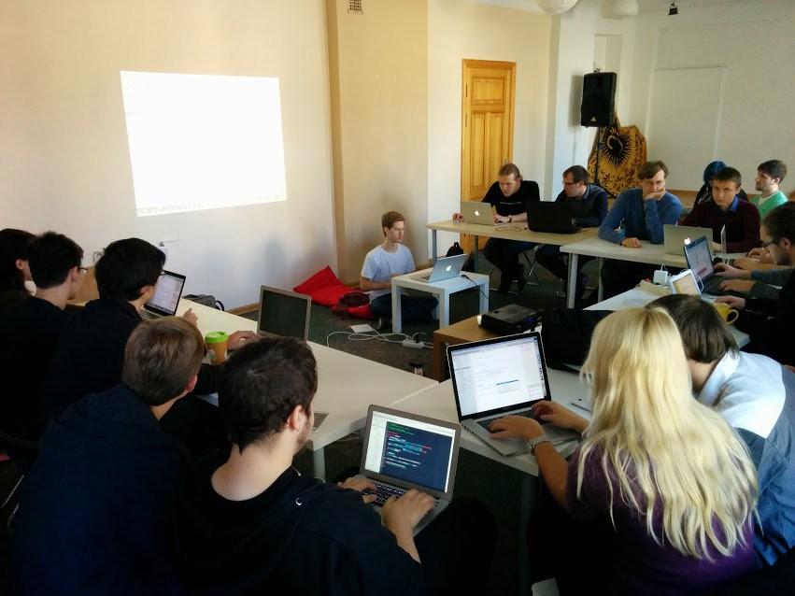
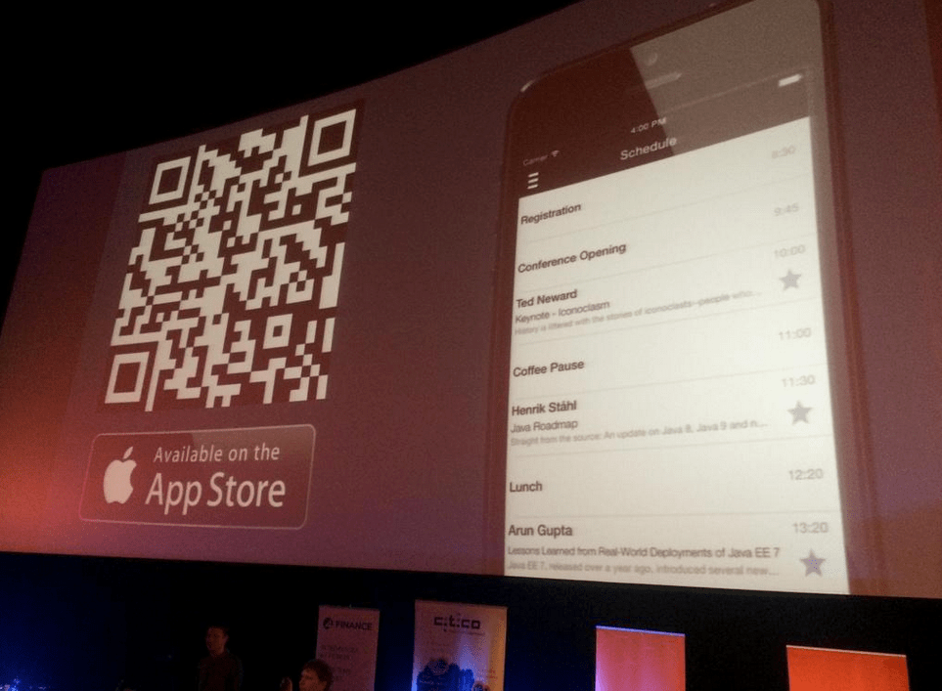
About Teacher
Worked in Enterprise & Startups
Worked as a freelancer
Hosted workshops and lectures at local mobile events
Publish numerous personal apps and collaborated projects

Slide 4
Course Goals:
Give practical experience of Android Apps creation
Introduce to commonly used Android elements (UI elements, camera, maps, etc.)
Show full development cycle from project creation to Google Play publication
Give enough skills to apply for a Trainee/Junior position as Android developer

Slide 5
1th lecture Agenda
Setup Course resources
Overview of Mobile vs Desktop programming paradigm
Overview of Android OS
Install Android Studio and Setup Emulator
Overview of Android Studio and project structure
Overview of Emulator possibilities
Write and run your first Android Application ☺

Slide 6
Course Resources
Slack invite: https://bit.ly/2H8ZP3r
Course repo: https://github.com/taier/java-guru-android-11-03-2019

Slide 7
Mobile VS Desktop

Slide 8

using device
While walking on the street
Queuing for something
Mostly consuming content

Slide 9
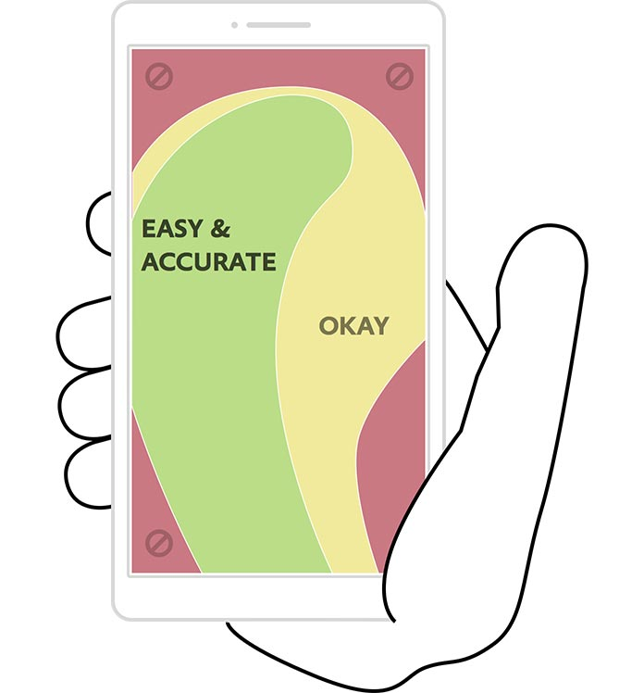
Smaller screen
Touch Input
No hover events
Less precision
Gestures
Tiny keyboard

Slide 10
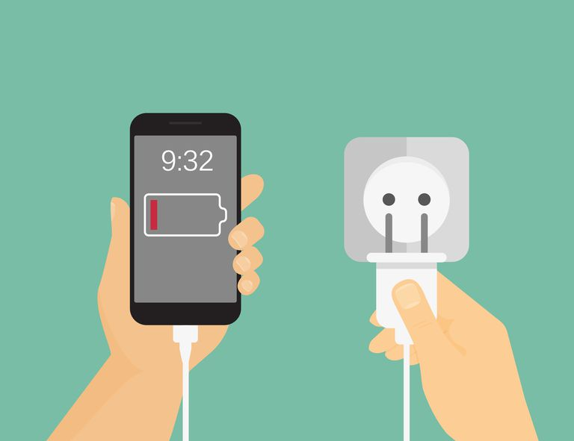
Battery Powered
Developers need to think about battery consumption
Can’t use 100% power of the phone all the time

Slide 11

ARM (ARISC) vs CISC architecture
ARM is power efficient
ARM is optimized for a small tasks
CISC perform better in complex calculations

Slide 12
Android basics

Slide 13
What is Android?
Android is a Linux-based operating system designed primarily for touchscreen mobile devices.
Initially developed by Android, Inc., which Google backed financially and later bought in 2005, Android was unveiled in 2007.
The first Android-powered phone was sold in October 2008.
Interact with the OS by swiping, tapping, pinching, reverse pinching, shaking, rotating the device etc.

Slide 14


Slide 15
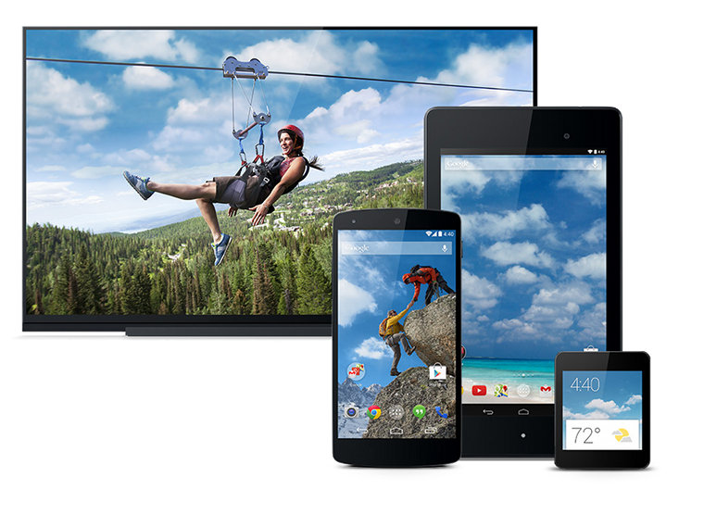
Devices Families
Phones
Tables
TVs
Watches
Cars
Refrigerators
Etc.

Slide 16
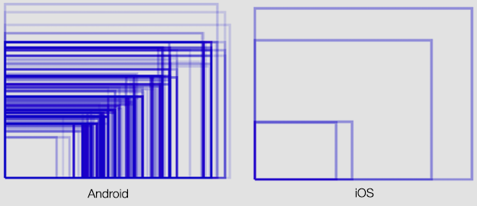
Screen sizes

Slide 17
Let’s explore Android Studio and Code first line of code in Android!

Slide 18
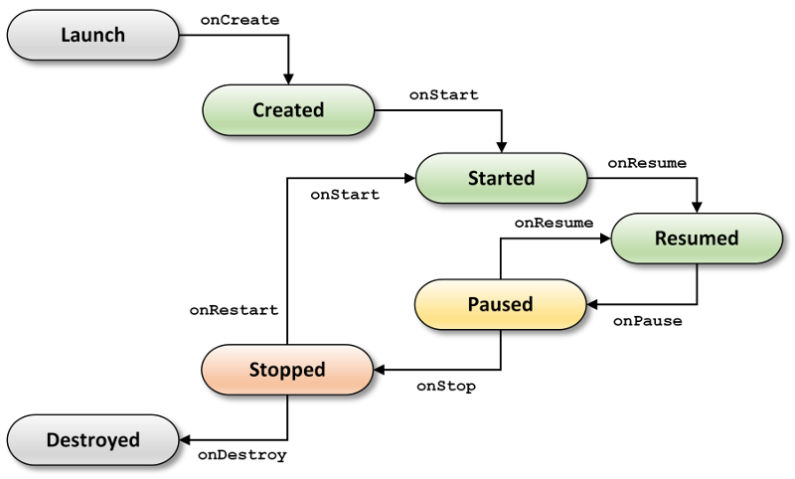
Activity lifecycle

Slide 19
TODO:
Change version of Application to 1.1
Add NFC usage permission
Create 3 square view of different colors
Arrange them vertically (|)
Add another line of 3 squares that arranged horizontally (---)
*Add another line of 3 squares that arranged like a stair (* - _)
Change their color on Application entering background
*Change their color by button press

Slide 20
Homework
Change version of Application to 2.0 (String)
Change minimum Android version to 5.1
Add Internet usage permission
Change button background color to Green (in code or in XML)
*On each App launch change main view background color to random one

Slide 21
How to hand homework
Zip and send to me directly via slack
Fork on github and push to your repo and send me link ☺

